Slide 1
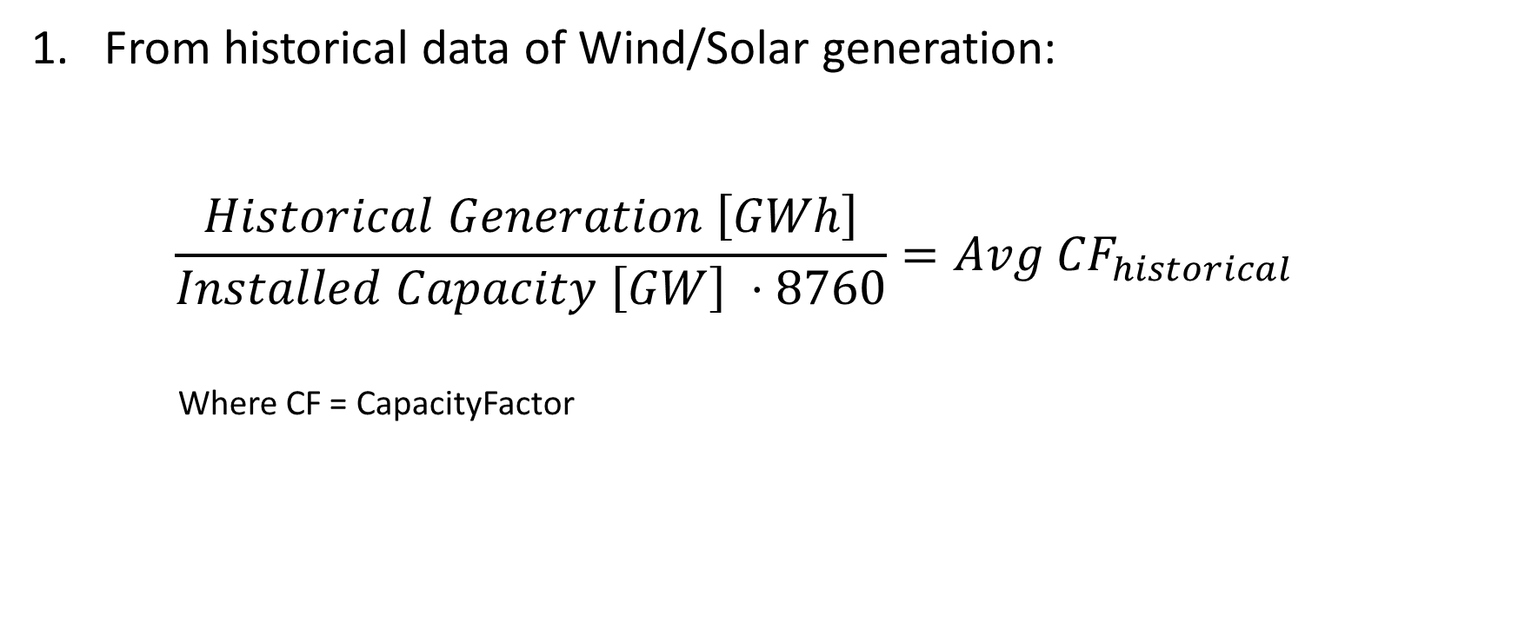
Capacity Factor: how to estimate it

Slide 2
Capacity Factor: how to estimate it
Access the online https://www.renewables.ninja/:

Slide 3
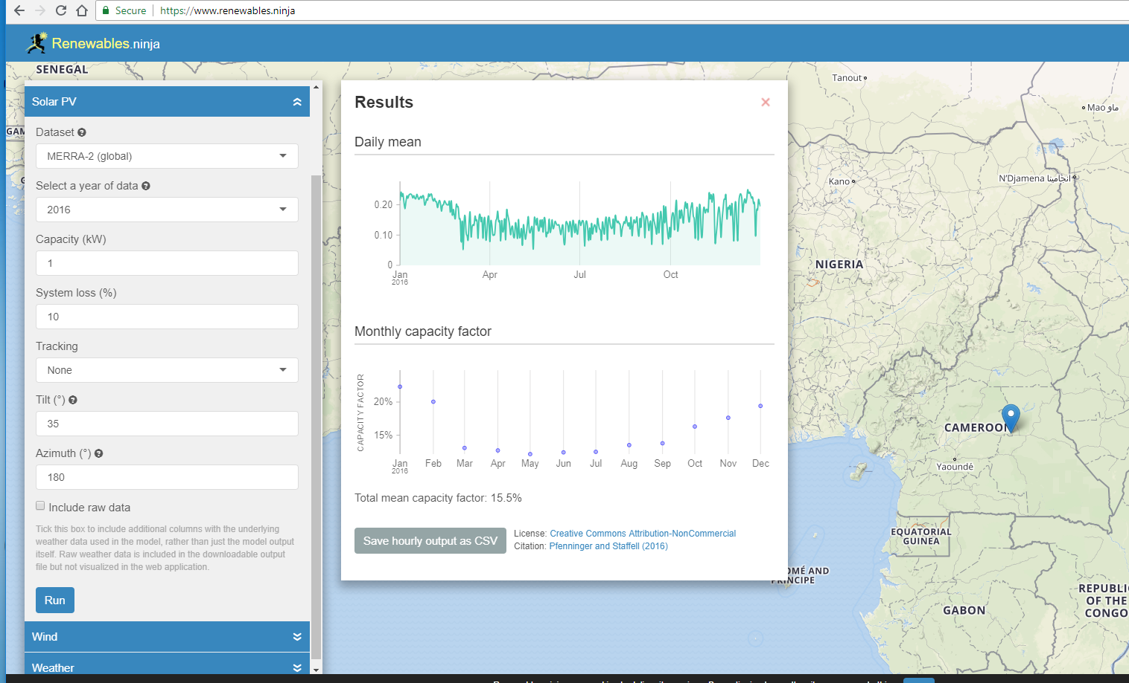
Capacity Factor: how to estimate it

Slide 4
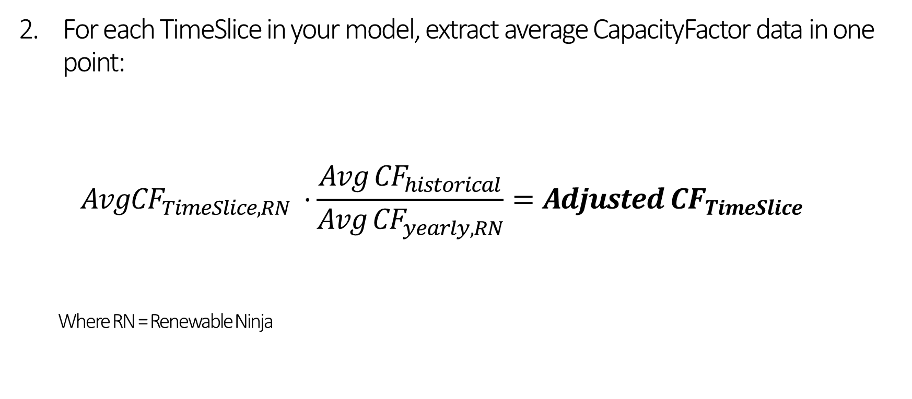
Capacity Factor: how to estimate it

